Slide 1
Department of Environmental Quality
May 11, 2016

Slide 2
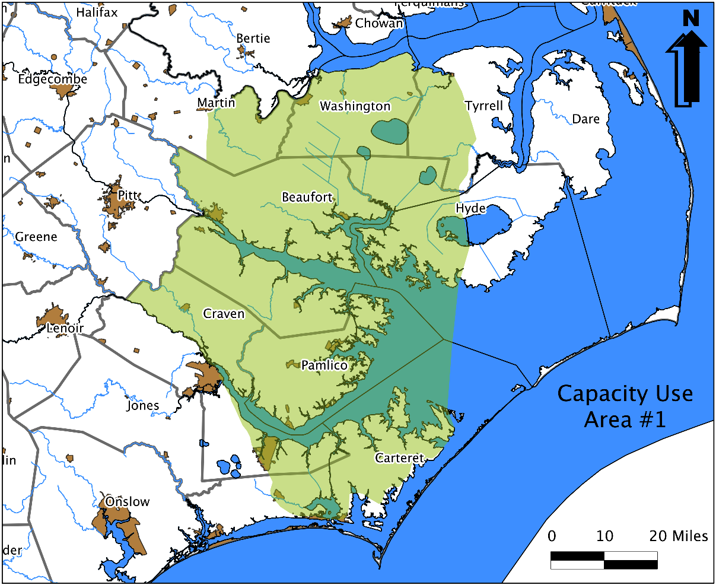
Regulation of Use of Water Resources
§143-215.11 - .22 Water Use Act of 1967 (Capacity Use Areas Law)
In 1967 NC enacted the first Capacity Use Law by a southeastern state in direct response to ground water problems that resulted from mining phosphate deposits in Beaufort County.
§ 143‑215.13. Declaration of capacity use areas.
  The Environmental Management Commission may declare and delineate from time to time, and may modify, capacity use areas of the State where it finds that the use of groundwater or surface water or both require coordination and limited regulation for protection of the interests and rights of residents or property owners of such areas or of the public interest.
§ 143‑215.22. Law of riparian rights not changed.
  Nothing contained in this Part shall change or modify existing common or statutory law with respect to the relative rights of riparian owners concerning the use of surface water in this State.
Department of Environmental Quality

Slide 3
Strengths & Weaknesses of the Water Use Act
Applies to all water withdrawals 100,000 gallon per day (gpd) or greater, potentially both surface and/or ground waters.
  Does NOT regulate small individual users less than 10,000 gpd.
Is a good solution for large regional water use issues were individual water withdrawals impact other users.
  NOT a good solution for small local water use problems.
Predates the Clean Water Act and includes provisions for water quality. Never been used to resolve water pollution problem.
Not a “one size fits all” solution. Ruling making process to design a withdrawal permitting process for specific problems for a defined geographical area of the State.
Department of Environmental Quality

Slide 4
History of Environmental Management Commission & Capacity Use Areas
Capacity Use Area 1 – Established in the early 1970’s because of the phosphate mining in Beaufort County.
Yadkin River – Late 1970’s concern for a proposed nuclear power plant in Davie County. The proposal was rejected and affirmed by the North Carolina Court of Appeals.
Eno River – Concerns in the mid-1980’s of inadequate flows in the Eno River in the area of the Eno River State Park. The fall of 1988 the EMC accepted a voluntary management plan (voluntary capacity use area) .(http://www.ncwater.org/Permits_and_Registration/Capacity_Use/Eno_River_Management/)
Currituck County Outer Banks – 1991, Division of Water Resources recommended a capacity use area not needed.
Roanoke Island – 1992, Division of Water Resources recommended a capacity use area not needed.
Central Coastal Plain Capacity Use Area – Rules became effective August 1, 2002. Superseded Capacity Use Area 1. (http://www.ncwater.org/?page=49&menu=Home)
Southern Coastal Plain – 2004, a regional solution was implement and a capacity use area not needed.
Department of Environmental Quality

Slide 5
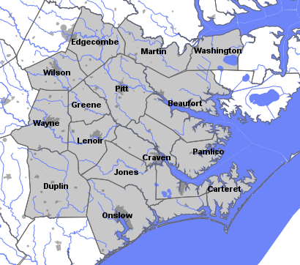
Central Coastal Plain Capacity Use Area
The CCPCUA came about in 2002 –after an investigation and ~4 year rule-making process
It covers 15 counties including much of the CUA #1 area to maintain protection of the Castle Hayne aquifer
Defined as a result of overuse of the Cretaceous aged (Black Creek and Upper Cape Fear) aquifers and the concern about saltwater encroachment
Evidence of dewatering of the aquifers and sharp declines in the water levels
Certain users faced reductions (between 30 and 75%) over a 16-year period from their 1997-2000 withdrawals
Forced investment in alternate water sources, especially surface water and shallower ground water
Water level recoveries are occurring in the endangered aquifers

Slide 6
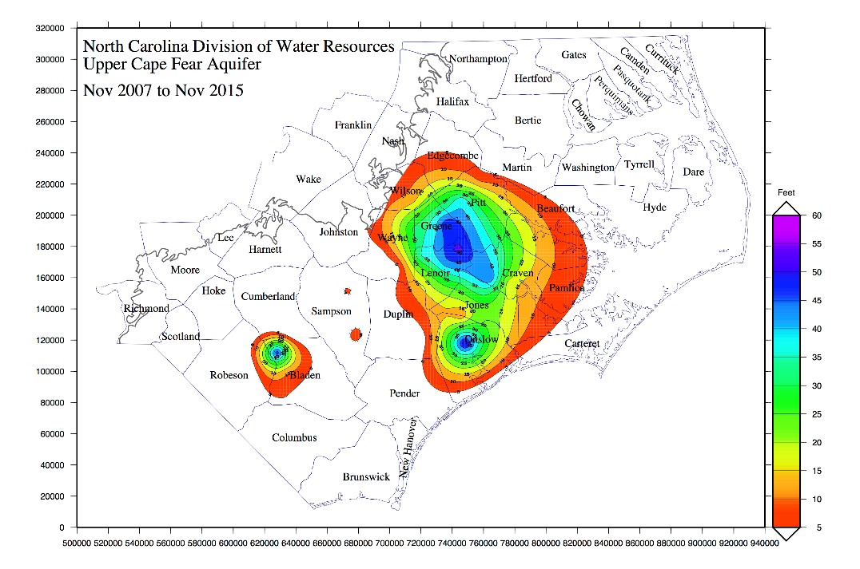
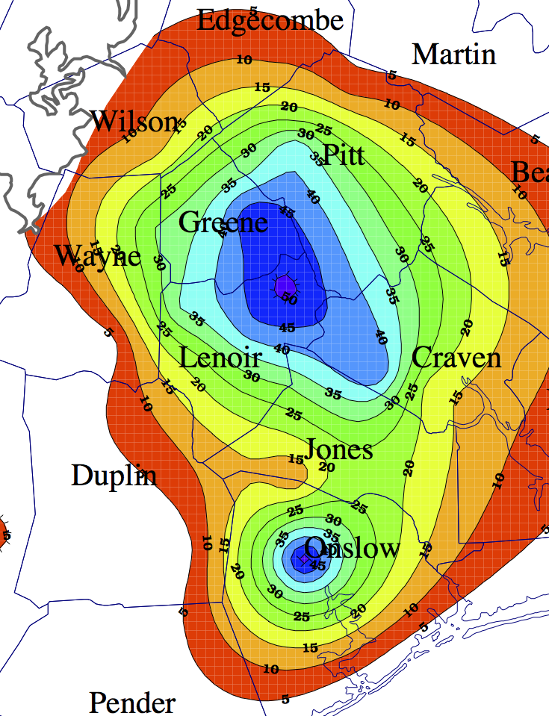
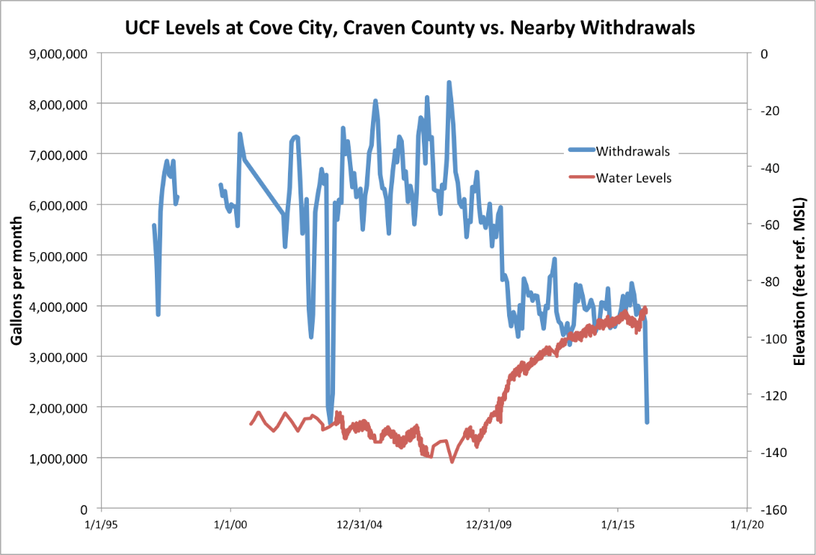
Upper Cape Fear Aquifer Recovery

Slide 7
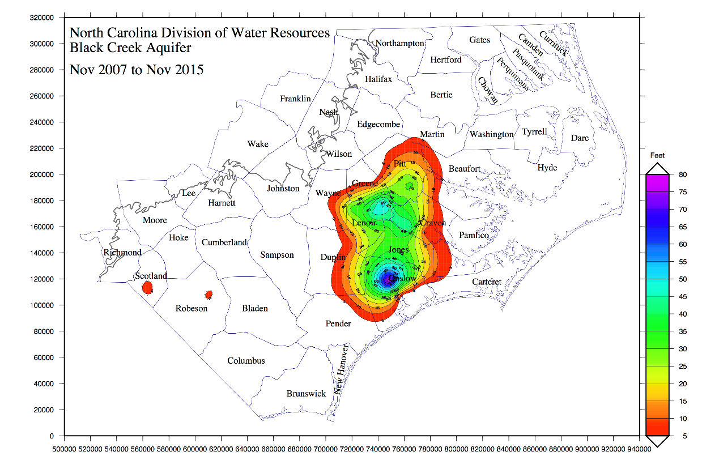
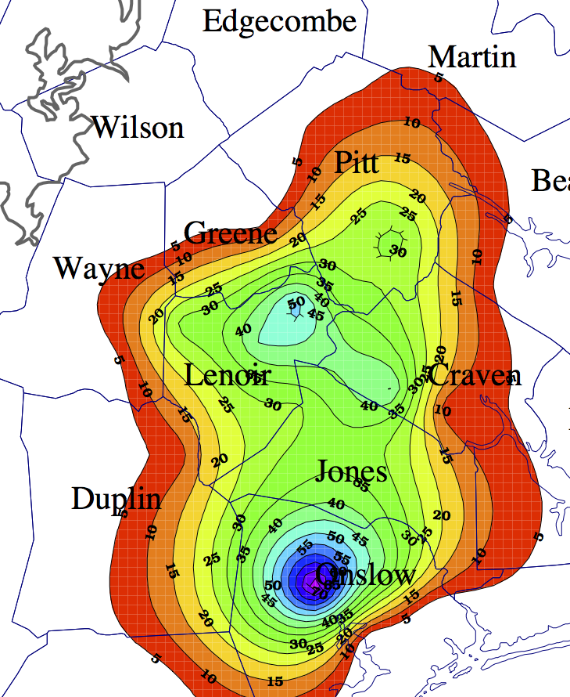
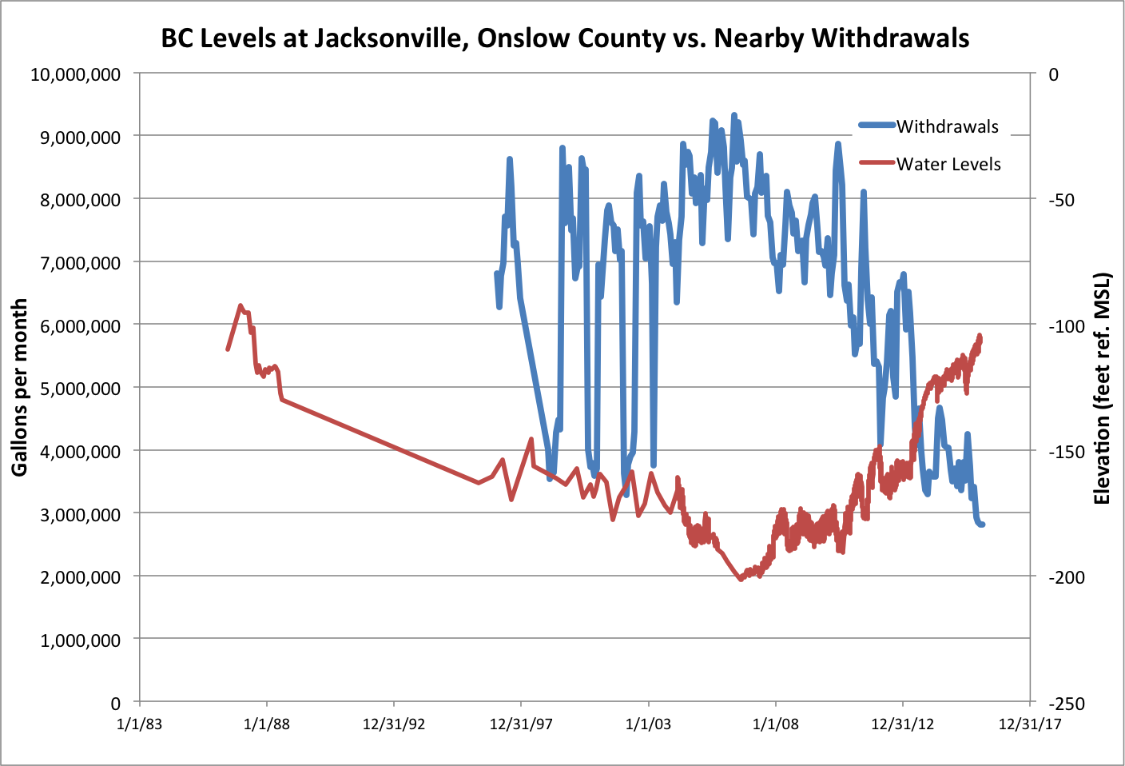
Black Creek Aquifer Recovery

Slide 8
3 Step Process
Environmental Management Commission (EMC) creates a “capacity use area” (CUA).
  § 143‑215.13. Declaration of capacity use areas. (b) Within the meaning of this Part "a capacity use area" is one where the Commission finds that the aggregate uses of groundwater or surface water, or both, in or affecting said area (i) have developed or threatened to develop to a degree which requires coordination and regulation, or (ii) exceed or threaten to exceed, or otherwise threaten or impair, the renewal or replenishment of such waters or any part of them.
Rule-making phase to develop the permitting program to respond to the quantity and/or quality problems of the CUA.
  § 143‑215.14. Rules within capacity use areas; scope and procedures. (a) Following the declaration of a capacity use area by the Commission, it shall prepare proposed rules to be applied in said area, containing such of the following provisions as the Commission finds appropriate concerning the use of surface waters or groundwaters or both:
Issuance of withdrawal permits for withdrawals over 100,000 gpd.
  § 143‑215.15. Rules within capacity use areas; scope and procedures.
  § 143‑215.16. Permits for water use within capacity use areas – Procedures.
Department of Environmental Quality

Slide 9
Step 1 - § 143‑215.13. Declaration of capacity use areas.
Environmental Management Commission (EMC) creates a “capacity use area” (CUA).
  § 143‑215.13. Declaration of capacity use areas.
    (b)Within the meaning of this Part "a capacity use area" is one where the Commission finds that the aggregate uses of groundwater or surface water, or both, in or affecting said area (i) have developed or threatened to develop to a degree which requires coordination and regulation, or (ii) exceed or threaten to exceed, or otherwise threaten or impair, the renewal or replenishment of such waters or any part of them.
    (c)The Commission may declare and delineate capacity use areas in accordance with the following procedures:
      (1) Whenever the Commission believes that a capacity use situation exists or may be emerging in any area of the State, it may direct the Department to investigate and report to the Commission thereon.
      (2) In conducting its investigation the Department shall ..
      (3) If the Commission finds, following its review of the departmental report (or thereafter following its evaluation of measures taken falling short of regulation) that a capacity use area should be declared, it may adopt a rule declaring said capacity use area. A rule declaring an area to be a capacity use area shall delineate the boundaries of the area. …
    (d)The Commission may conduct a public hearing pursuant to the provisions of this subsection in any area of the State, whether or not a capacity use area has been declared, when it has reason to believe that the withdrawal of water from or the discharge of water pollutants to the waters in such area is having an unreasonably adverse effect upon such waters. …
Department of Environmental Quality
Notes:
§ 143‑215.13. Declaration of capacity use areas.
(a) The Environmental Management Commission may declare and delineate from time to time, and may modify, capacity use areas of the State where it finds that the use of groundwater or surface water or both require coordination and limited regulation for protection of the interests and rights of residents or property owners of such areas or of the public interest.
(b) Within the meaning of this Part "a capacity use area" is one where the Commission finds that the aggregate uses of groundwater or surface water, or both, in or affecting said area (i) have developed or threatened to develop to a degree which requires coordination and regulation, or (ii) exceed or threaten to exceed, or otherwise threaten or impair, the renewal or replenishment of such waters or any part of them.
(c) The Commission may declare and delineate capacity use areas in accordance with the following procedures:
(1) Whenever the Commission believes that a capacity use situation exists or may be emerging in any area of the State, it may direct the Department to investigate and report to the Commission thereon.
(2) In conducting its investigation the Department shall consult with all interested persons, groups and agencies; may retain consultants; and shall consider all factors relevant to the conservation and use of water in the area, including established or pending water classifications under Part 1 of this Article and the criteria for such classifications. Following its investigation the Department shall render a written report to the Commission. This report shall indicate whether the water use problems of the area involve surface waters, groundwaters or both and shall identify the Department's suggested boundaries for any capacity use area that may be proposed. It shall present such alternatives as the Department deems appropriate, including actions by any agency or person which might preclude the need for additional regulation at that time, and measures which might be employed limited to surface water or groundwater.
(3) If the Commission finds, following its review of the departmental report (or thereafter following its evaluation of measures taken falling short of regulation) that a capacity use area should be declared, it may adopt a rule declaring said capacity use area. A rule declaring an area to be a capacity use area shall delineate the boundaries of the area.
(4) to (6) Repealed by Session Laws 1981, c. 585, s. 3.
(7) Repealed by Session Laws 1987, c. 827, s. 167.
(d) The Commission may conduct a public hearing pursuant to the provisions of this subsection in any area of the State, whether or not a capacity use area has been declared, when it has reason to believe that the withdrawal of water from or the discharge of water pollutants to the waters in such area is having an unreasonably adverse effect upon such waters. If the Commission determines that withdrawals of water from or discharge of water pollutants to the waters within such area has resulted or probably will result in a generalized condition of water depletion or water pollution within the area to the extent that the availability or fitness for use of such water has been impaired for existing or proposed uses and that injury to the public health, safety or welfare will result if increased or additional withdrawals or discharges occur, the Commission may issue a rule:
(1) Prohibiting any person withdrawing waters in excess of 100,000 gallons per day from increasing the amount of the withdrawal above such limit as may be established in the rule.
(2) Prohibiting any person from constructing, installing or operating any new well or withdrawal facilities having a capacity in excess of a rate established in the rule; but such prohibition shall not extend to any new well or facility having a capacity of less than 10,000 gallons per day.
(3) Prohibiting any person discharging water pollutants to the waters from increasing the rate of discharge in excess of the rate established in the rule.
(4) Prohibiting any person from constructing, installing or operating any facility that will or may result in the discharge of water pollutants to the waters in excess of the rate established in the rule.
(5) Prohibiting any agency or political subdivision of the State from issuing any permit or similar document for the construction, installation, or operation of any new or existing facilities for withdrawing water from or discharging water pollutants to the waters in such area in excess of the rates established in the rule.
The determination of the Commission shall be based upon the record of the public hearing and other information considered by the Commission in the rule‑making proceeding. The rule shall describe the geographical area of the State affected thereby with particularity and shall provide that the prohibitions set forth therein shall continue pending a determination by the Commission that the generalized condition of water depletion or water pollution within the area has ceased.
Upon issuance of any rule by the Commission pursuant to this subsection, a certified copy of such rule shall be mailed by registered or certified mail to the governing body of every county, city, town, and affected political subdivision lying, in whole or in part, within the area and to every affected or interested State and federal agency. A certified copy of the rule shall be posted at the courthouse in every county lying, in whole or in part, within the area, and a notice setting forth the substantive provisions and effective date of the rule shall be published once a week for two successive weeks in a newspaper or newspapers having general circulation within the area. After publication of notice is completed, any person violating any provision of such rule after the effective date thereof shall be subject to the penalties and proceedings set forth in G.S. 143‑215.17. (1967, c. 933, s. 3; 1973, c. 698, s. 14; c. 1262, s. 23; 1977, c. 771, s. 4; 1981, c. 585, ss. 1‑4; 1987, c. 827, ss. 154, 167.)

Slide 10
Step 2 - § 143‑215.14. Rules within capacity use areas
Rule-making phase to develop the permitting program to respond to the quantity and/or quality problems of the CUA.
§ 143‑215.14. Rules within capacity use areas; scope and procedures.
  (a) Following the declaration of a capacity use area by the Commission, it shall prepare proposed rules to be applied in said area, containing such of the following provisions as the Commission finds appropriate concerning the use of surface waters or groundwaters or both:
    (1) Provisions requiring water users within the area to submit reports not more frequently than at 30‑day intervals concerning quantity of water used or withdrawn, sources of water and the nature of the use thereof.
    (2) With respect to surface waters, groundwaters, or both: provisions concerning the timing of withdrawals; provisions to protect against or abate salt water encroachment; provisions to protect against or abate unreasonable adverse effects on other water users within the area, including but not limited to adverse effects on public use.
    (3) With respect to groundwaters: provisions concerning well‑spacing controls; and provisions establishing a range of prescribed pumping levels (elevations below which water may not be pumped) or maximum pumping rates, or both, in wells or for the aquifer or for any part thereof based on the capacities and characteristics of the aquifer.
    (4) Such other provisions not inconsistent with this Part as the Commission finds necessary to implement the purposes of this Part.
  (b)In adopting rules for a capacity use area, the Commission shall consider the factors listed in G.S. 143‑215.15(h). (G.S. 143‑215.15(h) the 9 factors to consider in issuing a permit.)
Department of Environmental Quality
Notes:
§ 143‑215.15. Permits for water use within capacity use areas – Procedures.
(h) In determining whether to issue, modify, revoke, or deny a permit under this section, the Commission shall consider:
(1) The number of persons using an aquifer or stream and the object, extent and necessity of their respective withdrawals or uses;
(2) The nature and size of the stream or aquifer;
(3) The physical and chemical nature of any impairment of the aquifer or stream, adversely affecting its availability or fitness for other water uses (including public use);
(4) The probable severity and duration of such impairment under foreseeable conditions;
(5) The injury to public health, safety or welfare which would result if such impairment were not prevented or abated;
(6) The kinds of businesses or activities to which the various uses are related;
(7) The importance and necessity of the uses claimed by permit applicants (under this section), or of the water uses of the area (under G.S. 143‑215.14) and the extent of any injury or detriment caused or expected to be caused to other water uses (including public use);
(8) Diversion from or reduction of flows in other watercourses or aquifers; and
(9) Any other relevant factors.

Slide 11
Step 3 - Permits for water use within capacity use areas
Issuance of withdrawal permits for withdrawals over 100,000 gpd.
  § 143‑215.15. Rules within capacity use areas; scope and procedures.
  § 143‑215.16. Permits for water use within capacity use areas – Procedures.
  § 143‑215.17. Enforcement procedures.
  § 143‑215.18. Map or description of boundaries of capacity use areas.
  § 143‑215.19. Administrative inspection; reports.
Department of Environmental Quality

Slide 12
Next Steps
  Division of Water Resources in the integrated basin plans will:
    As part of the water supply evaluation determine if surface and/or ground water conditions meet the Water Use Act criteria for being declared a capacity use area.
    If appropriate include a recommendation for the EMC to consider starting the Capacity Use declaration process for the river basin or a portion of the basin.
Department of Environmental Quality

Slide 13
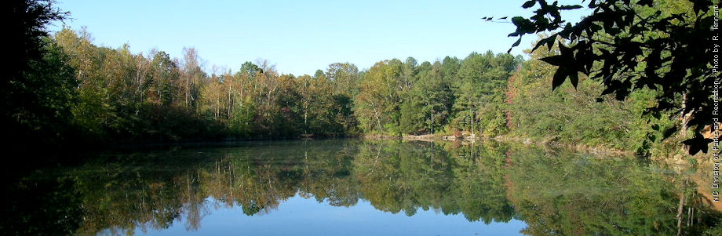
Contact Information
Tom Fransen
Chief, Water Supply Planning Section
Division of Water Resources
919-707-9015
tom.fransen@ncdenr.gov
Department of Environmental Quality

